Slide 1
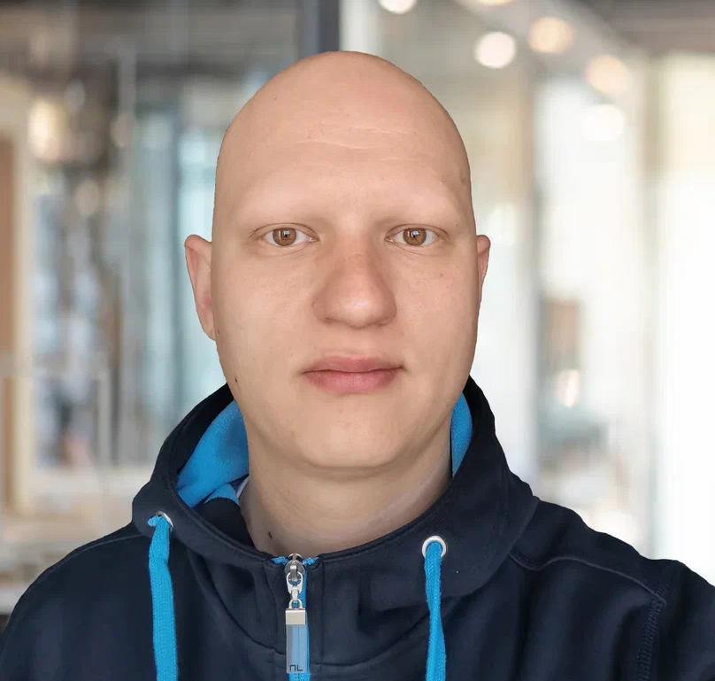
Pavel Purlantov
Software Consultant
Command pattern и MediatR в .Net

Slide 2
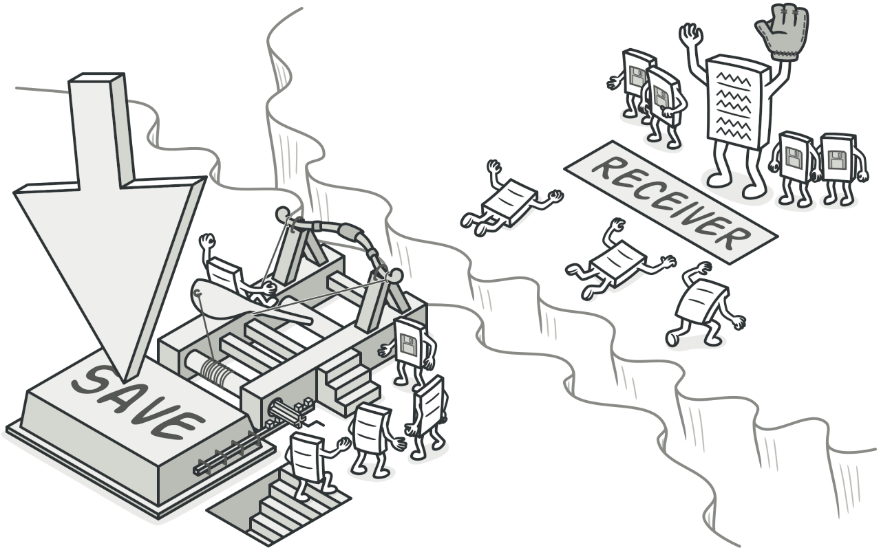

Agenda
What is Command Pattern?
What is MediatR?
What are thin controllers?
How to use MediatR in .NET?
Examples.
Q & A.
Command Pattern
MediatR library

Slide 4




Contacts:
Linkedin profile
Facebook profile
Github profile
Instagram profile

